Slide 1
5
Pervasive Computing
Dr. Asawari Dudwadkar
Asst.Prof. ECS Dept.

Slide 2
Pervasive Computing
Cloud computing Model

Slide 3
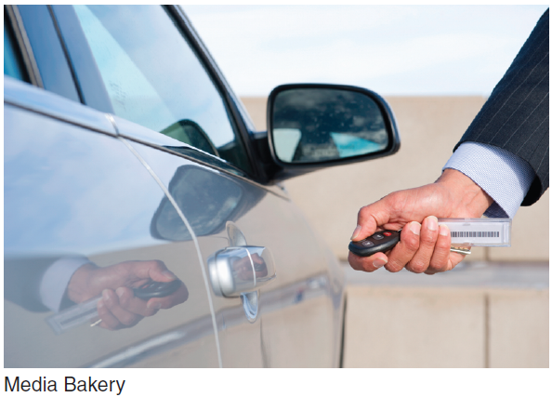
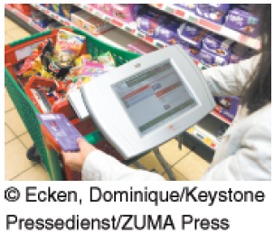
Pervasive Computing
Radio-Frequency Identification (RFID)
Wireless Sensor Networks
The Internet of Things
Notes:
Radio-Frequency Identification (RFID): technology that allows manufacturers to attach tags with antennas and computer chips on goods and then track their movement through radio signals. RFID was developed to replace bar codes.
Wireless Sensor Networks (WSNs): networks of interconnected, battery powered, wireless sensors called motes that are placed into the physical environment.
Internet of Things (IoT): a scenario in which objects, animals, and people are provided with unique identifiers and the ability to automatically transfer data over a network without requiring human-to-human or human-to-computer interaction.

Slide 4
Pervasive Computing
Radio-Frequency Identification (RFID): technology that allows manufacturers to attach tags with antennas and computer chips on goods and then track their movement through radio signals. RFID was developed to replace bar codes.
Wireless Sensor Networks (WSNs): networks of interconnected, battery powered, wireless sensors called motes that are placed into the physical environment.
Internet of Things (IoT): a scenario in which objects, animals, and people are provided with unique identifiers and the ability to automatically transfer data over a network without requiring human-to-human or human-to-computer interaction.
Notes:
Radio-Frequency Identification (RFID): technology that allows manufacturers to attach tags with antennas and computer chips on goods and then track their movement through radio signals. RFID was developed to replace bar codes.
Wireless Sensor Networks (WSNs): networks of interconnected, battery powered, wireless sensors called motes that are placed into the physical environment.
Internet of Things (IoT): a scenario in which objects, animals, and people are provided with unique identifiers and the ability to automatically transfer data over a network without requiring human-to-human or human-to-computer interaction.

Slide 5
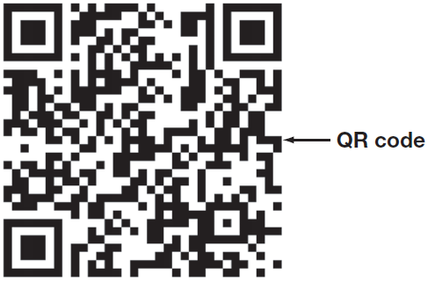
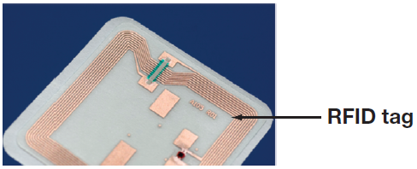
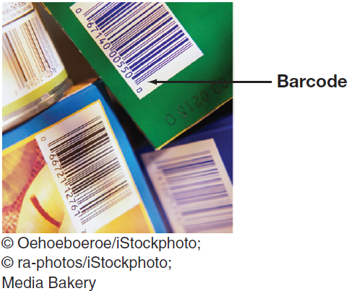
Radio-Frequency Identification (RFID)
RFID
Bar Codes
QR Codes
Notes:
Radio-Frequency Identification (RFID): technology that allows manufacturers to attach tags with antennas and computer chips on goods and then track their movement through radio signals. RFID was developed to replace bar codes.
Universal Product Code (UPC): A typical bar code made up of 12 digits that are batched in various groups. The first digit identifies the item type, the next five digits identify the manufacturer, and the next five identify the product. The last digit is a check digit for error detection.
RFID Systems: tags have embedded microchips, which contain data, and antennas to transmit radio signals over a short distance to RFID readers including information that uniquely identifies an item (location and when it was made).
QR code: a two-dimensional code, readable by dedicated QR readers and camera phones
Limitations of Bar codes:
Require a line of sight to the scanning device
Pose substantial problems in a manufacturing plant, warehouse or shipping/receiving dock
can be ripped, soiled, or lost
identifies the manufacturer and product but not the actual item
Two Basic Types of RFID Tags:
Active RFID: tags that use internal batteries for power, and they broadcast radio waves to a reader.
Passive RFID: tags rely entirely on readers for their power, less expensive than active tags, and can be read only up to 20 feet.

Slide 6
RFID
RFID Systems
Two Basic Types of RFID Tags
Active RFID: tags that use internal batteries for power, and they broadcast radio waves to a reader.
Passive RFID: tags rely entirely on readers for their power, less expensive than active tags, and can be read only up to 20 feet.
Notes:
Radio-Frequency Identification (RFID): technology that allows manufacturers to attach tags with antennas and computer chips on goods and then track their movement through radio signals. RFID was developed to replace bar codes.
RFID Systems: tags have embedded microchips, which contain data, and antennas to transmit radio signals over a short distance to RFID readers including information that uniquely identifies an item (location and when it was made).
Two Basic Types of RFID Tags:
Active RFID: tags that use internal batteries for power, and they broadcast radio waves to a reader.
Passive RFID: tags rely entirely on readers for their power, less expensive than active tags, and can be read only up to 20 feet.

Slide 7
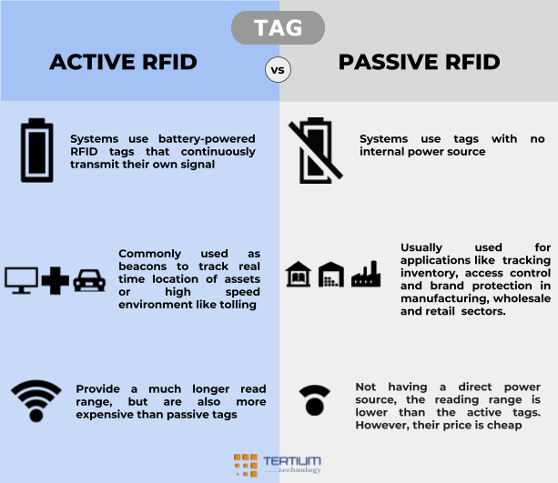

Slide 8
Bar Codes
Universal Product Code (UPC): A typical bar code made up of 12 digits that are batched in various groups. The first digit identifies the item type, the next five digits identify the manufacturer, and the next five identify the product. The last digit is a check digit for error detection.
Limitations of Bar codes:
Require a line of sight to the scanning device
Pose substantial problems in a manufacturing plant, warehouse or shipping/receiving dock
Paper bar codes can be ripped, soiled, or lost
identifies the manufacturer and product but not the actual item
Notes:
Universal Product Code (UPC): A typical bar code made up of 12 digits that are batched in various groups. The first digit identifies the item type, the next five digits identify the manufacturer, and the next five identify the product. The last digit is a check digit for error detection.
Limitations of Bar codes:
Require a line of sight to the scanning device
Pose substantial problems in a manufacturing plant, warehouse or shipping/receiving dock
Paper bar codes can be ripped, soiled, or lost
identifies the manufacturer and product but not the actual item

Slide 9
QR Codes: Advantages Over Bar Codes
QR code: a two-dimensional code, readable by dedicated QR readers and camera phones
Advantages of QR codes (over bar codes):
QR codes can store much more information.
Data types stored in QR codes include numbers, text, URLs, and even Japanese characters.
QR codes are smaller because they store information both horizontally and vertically.
QR codes can be read from any direction or angle, so they are less likely to be misread.
QR codes are more resistant to damage.
Notes:
QR code: a two-dimensional code, readable by dedicated QR readers and camera phones
Advantages of QR codes (over bar codes):
• QR codes can store much more information.
• Data types stored in QR codes include numbers, text, URLs, and even Japanese characters.
• QR codes are smaller because they store information both horizontally and vertically.
• QR codes can be read from any direction or angle, so they are less likely to be misread.
• QR codes are more resistant to damage.

Slide 10
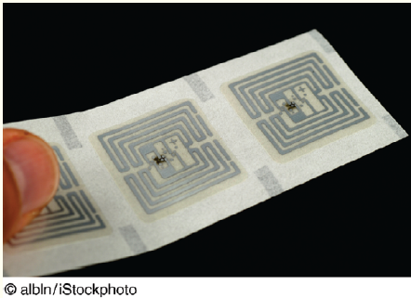
’S ABOUT BUSINESS 10.5
Marks & Spencer Embraces RFID
Describe how RFID technology can generate increased customer satisfaction.
What are potential disadvantages to implementing RFID technology in a retailer such as Marks & Spencer?
Why did Marks & Spencer initially deploy RFID technology on a limited basis? In your opinion, was this the correct strategy? Why or why not? Be specific.

Slide 11
Wireless Sensor Networks
Motes
Capability of Wireless Sensor Networks
Applications of Wireless Sensor Networks
Notes:
Wireless Sensor Networks (WSNs): networks of interconnected, battery powered, wireless sensors called motes that are placed into the physical environment.
Motes: wireless sensors that collect data from many points over an extended space. They contain processing, storage, and radio-frequency sensors and antennas. Each mote “wakes up” or activates for a fraction of a second when it has data to transmit. It then relays those data to its nearest neighbor. An advantage of a wireless sensor network is that if one mote fails, then another one can pick up the data.
Motes provide information that enables a central computer to integrate reports of the same activity from different angles within the network.
Mote networks can determine with much greater accuracy information such as the direction in which a person is moving, the weight of a vehicle, and the amount of rainfall over a field of crops.
Applications of Wireless Sensors:
Digital thermostats = energy efficiency
sensors in bridges and oil rigs = alerts of needed repairs
Sensors in jet engines = real time data on operating performance
Sensors in fruit & vegetable crates = warning in advance of spoilage
Improve a city’s use of water, electricity, and transportation
Smart/digital water meters = monitoring of water use and potential leaks
Smart electrical meters = smart grid monitoring electricity usage

Slide 12
Wireless Sensor Networks
Wireless Sensor Networks (WSNs): networks of interconnected, battery powered, wireless sensors called motes that are placed into the physical environment.
Motes: wireless sensors that collect data from many points over an extended space.
They contain processing, storage, and radio-frequency sensors and antennas.
Each mote “wakes up” or activates for a fraction of a second when it has data to transmit.
It then relays those data to its nearest neighbor.
An advantage of a wireless sensor network is that if one mote fails, then another one can pick up the data.
Motes provide information that enables a central computer to integrate reports of the same activity from different angles within the network.
Notes:
Wireless Sensor Networks (WSNs): networks of interconnected, battery powered, wireless sensors called motes that are placed into the physical environment.
Motes: wireless sensors that collect data from many points over an extended space. They contain processing, storage, and radio-frequency sensors and antennas. Each mote “wakes up” or activates for a fraction of a second when it has data to transmit. It then relays those data to its nearest neighbor. An advantage of a wireless sensor network is that if one mote fails, then another one can pick up the data.
Motes provide information that enables a central computer to integrate reports of the same activity from different angles within the network.
Mote networks can determine with much greater accuracy information such as the direction in which a person is moving, the weight of a vehicle, and the amount of rainfall over a field of crops.
Applications of Wireless Sensors:
Digital thermostats = energy efficiency
sensors in bridges and oil rigs = alerts of needed repairs
Sensors in jet engines = real time data on operating performance
Sensors in fruit & vegetable crates = warning in advance of spoilage
Improve a city’s use of water, electricity, and transportation
Smart/digital water meters = monitoring of water use and potential leaks
Smart electrical meters = smart grid monitoring electricity usage

Slide 13
Capability of Wireless Sensor Networks
If one mote fails the gap is covered by nearby motes
Provides data on activities from different angles
Determine direction of movement
Weight of a vehicle
Amount of rainfall over a field of crops
Notes:
Wireless Sensor Networks (WSNs): networks of interconnected, battery powered, wireless sensors called motes that are placed into the physical environment.
Motes: wireless sensors that collect data from many points over an extended space. They contain processing, storage, and radio-frequency sensors and antennas. Each mote “wakes up” or activates for a fraction of a second when it has data to transmit. It then relays those data to its nearest neighbor. An advantage of a wireless sensor network is that if one mote fails, then another one can pick up the data.
Motes provide information that enables a central computer to integrate reports of the same activity from different angles within the network.
Mote networks can determine with much greater accuracy information such as the direction in which a person is moving, the weight of a vehicle, and the amount of rainfall over a field of crops.

Slide 14
Applications of Wireless Sensor Networks
Applications of Wireless Sensors:
Digital thermostats = energy efficiency
sensors in bridges and oil rigs = alerts of needed repairs
Sensors in jet engines = real time data on operating performance
Sensors in fruit & vegetable crates = warning in advance of spoilage
Improve a city’s use of water, electricity, and transportation
Smart/digital water meters = monitoring of water use and potential leaks
Smart electrical meters = smart grid monitoring electricity usage
Notes:
Applications of Wireless Sensors:
Digital thermostats = energy efficiency
sensors in bridges and oil rigs = alerts of needed repairs
Sensors in jet engines = real time data on operating performance
Sensors in fruit & vegetable crates = warning in advance of spoilage
Improve a city’s use of water, electricity, and transportation
Smart/digital water meters = monitoring of water use and potential leaks
Smart electrical meters = smart grid monitoring electricity usage

Slide 15
The Internet of Things (IoT)
Internet of Things (IoT): a scenario in which objects, animals, and people are provided with unique identifiers and the ability to automatically transfer data over a network without requiring human-to-human or human-to-computer interaction.
Examples of IoT Use:
Coke machines
A heart monitor implant
A farm animal with a biochip transmitter
An automobile tire pressure
Capabilities of IoT:
Reducing waste, loss, and cost
Identifying the need for repair, replacement, or recall
Tracking expiry data on perishable items
Notes:
Internet of Things (IoT): a scenario in which objects, animals, and people are provided with unique identifiers and the ability to automatically transfer data over a network without requiring human-to-human or human-to-computer interaction.
Examples of IoT Use:
Coke machines
A heart monitor implant
A farm animal with a biochip transmitter
An automobile tire pressure
Capabilities of IoT:
Reducing waste, loss, and cost
Identifying the need for repair, replacement, or recall
Tracking expiration data on perishable items

Slide 16
Wireless Security
Four Major Threats to Wireless Networks
Rogue Access Point (Evil Twin)
War Driving
Eavesdropping
Radio Frequency Jamming
Notes:
Four Major Threats to Wireless Networks:
Rogue Access Point: an unauthorized access point connected to a wireless network.
Evil Twin Attack: the attacker is in the vicinity with a Wi-Fi-enabled computer and a separate connection to the Internet. Using a hotspotter—a device that detects wireless networks and provides information on them the attacker simulates a wireless access point with the same wireless network name, or SSID, as the one that authorized users expect. If the signal is strong enough, users will connect to the attacker’s system instead of the real access point.
War Driving: the act of locating WLANs while driving (or walking) around a city or elsewhere.
Eavesdropping: efforts by unauthorized users to access data that are traveling over wireless networks.
Radio-Frequency (RF) Jamming: a person or a device intentionally or unintentionally interferes with your wireless network transmissions.

Slide 17
Wireless Security
Four Major Threats to Wireless Networks:
Rogue Access Point: an unauthorized access point connected to a wireless network.
Evil Twin Attack: the attacker is in the locality with a Wi-Fi-enabled computer and a separate connection to the Internet. Using a hotspot—attacker simulates a wireless access point with the same wireless network name, or SSID, as the one that authorized users expect. If the signal is strong enough, users will connect to the attacker’s system instead of the real access point.
War Driving: the act of locating WLANs while driving (or walking) around a city or elsewhere.
Eavesdropping: efforts by unauthorized users to access data that are traveling over wireless networks.
Radio-Frequency (RF) Jamming: a person or a device intentionally or unintentionally interferes with your wireless network transmissions.
Notes:
Four Major Threats to Wireless Networks:
Rogue Access Point: an unauthorized access point connected to a wireless network.
Evil Twin Attack: the attacker is in the vicinity with a Wi-Fi-enabled computer and a separate connection to the Internet. Using a hotspotter—a device that detects wireless networks and provides information on them the attacker simulates a wireless access point with the same wireless network name, or SSID, as the one that authorized users expect. If the signal is strong enough, users will connect to the attacker’s system instead of the real access point.
War Driving: the act of locating WLANs while driving (or walking) around a city or elsewhere.
Eavesdropping: efforts by unauthorized users to access data that are traveling over wireless networks.
Radio-Frequency (RF) Jamming: a person or a device intentionally or unintentionally interferes with your wireless network transmissions.

Slide 18
Cloud Computing

Slide 19
Cloud Computing
Introduction
Six Stages of IT Infrastructure Evolution
Stand-alone Mainframes
Mainframe & Dumb Terminals
Stand-alone Personal Computers
Local Area Networks
Enterprise Computing
Cloud Computing and Mobile Computing
Notes:
Cloud Computing: a type of computing that delivers convenient, on-demand, pay-as-you-go access for multiple customers to a shared pool of configurable computing resources (e.g., servers, networks, storage, applications, and services) that can be rapidly and easily accessed over the Internet. Cloud computing allows customers to acquire resources at any time and then delete them the instant they are no longer needed.
Six Stages of Modern IT Infrastructure Evolution
1. Stand-alone Mainframes: Organizations initially used mainframe computers in their engineering and accounting departments. The mainframe was typically housed in a secure area, and only MIS personnel had access to it.
2. Mainframe & Dumb Terminals: Forcing users to go to wherever the mainframe was located was time consuming and inefficient. As a result, firms began placing so-called “dumb terminals”—essentially electronic typewriters with limited processing power—in user departments. This arrangement enabled users to input computer programs into the mainframe from their departments, a process called remote job entry.
3. Stand-alone Personal Computers: In the late 1970s, the first personal computers appeared. The IBM PC’s debut in 1981 legitimized the entire personal computer market. Users began bringing personal computers to the workplace to improve their productivity—for example, by using spreadsheet and word processing applications. These computers were not initially supported by the firm’s MIS department. However, as the number of personal computers increased dramatically, organizations decided to support these devices, and they established policies as to which PCs and soft ware they would support.
4. Local Area Networks: (client/server computing). When personal computers are networked, individual productivity is substantially increased. For this reason, organizations began to connect personal computers into local area networks (LANs) and then connect these LANs to the mainframe, a type of processing known as client/server computing.
5. Enterprise Computing: In the early 1990s, organizations began to use networking standards to integrate different kinds of networks throughout the firm, thereby creating enterprise computing. As the Internet became widespread after 1995, organizations began using the TCP/IP networking protocol to integrate different types of networks. All types of hardware were networked, from mainframes to personal computers to smartphones. Soft ware applications and data could now flow seamlessly throughout the enterprise and between organizations.
6. Cloud Computing and Mobile Computing: Today, organizations and individuals can use the power of cloud computing. As you will see in this Plug IT In, cloud computing provides access to a shared pool of computing resources, including computers, storage, applications, and services, over a network, typically the Internet.

Slide 20
.....Cloud Computing
Cloud Computing:
A type of computing that delivers convenient, on-demand, pay-as-you-go access for multiple customers to a shared pool of configurable computing resources (e.g., servers, networks, storage, applications, and services) that can be rapidly and easily accessed over the Internet.
Cloud computing allows customers to acquire resources at any time and then delete them the instant they are no longer needed.
Notes:
Cloud Computing: a type of computing that delivers convenient, on-demand, pay-as-you-go access for multiple customers to a shared pool of configurable computing resources (e.g., servers, networks, storage, applications, and services) that can be rapidly and easily accessed over the Internet. Cloud computing allows customers to acquire resources at any time and then delete them the instant they are no longer needed.
Six Stages of Modern IT Infrastructure Evolution
1. Stand-alone Mainframes: Organizations initially used mainframe computers in their engineering and accounting departments. The mainframe was typically housed in a secure area, and only MIS personnel had access to it.
2. Mainframe & Dumb Terminals: Forcing users to go to wherever the mainframe was located was time consuming and inefficient. As a result, firms began placing so-called “dumb terminals”—essentially electronic typewriters with limited processing power—in user departments. This arrangement enabled users to input computer programs into the mainframe from their departments, a process called remote job entry.
3. Stand-alone Personal Computers: In the late 1970s, the first personal computers appeared. The IBM PC’s debut in 1981 legitimized the entire personal computer market. Users began bringing personal computers to the workplace to improve their productivity—for example, by using spreadsheet and word processing applications. These computers were not initially supported by the firm’s MIS department. However, as the number of personal computers increased dramatically, organizations decided to support these devices, and they established policies as to which PCs and soft ware they would support.
4. Local Area Networks: (client/server computing). When personal computers are networked, individual productivity is substantially increased. For this reason, organizations began to connect personal computers into local area networks (LANs) and then connect these LANs to the mainframe, a type of processing known as client/server computing.
5. Enterprise Computing: In the early 1990s, organizations began to use networking standards to integrate different kinds of networks throughout the firm, thereby creating enterprise computing. As the Internet became widespread after 1995, organizations began using the TCP/IP networking protocol to integrate different types of networks. All types of hardware were networked, from mainframes to personal computers to smartphones. Soft ware applications and data could now flow seamlessly throughout the enterprise and between organizations.
6. Cloud Computing and Mobile Computing: Today, organizations and individuals can use the power of cloud computing. As you will see in this Plug IT In, cloud computing provides access to a shared pool of computing resources, including computers, storage, applications, and services, over a network, typically the Internet.

Slide 21
....Cloud Computing
Six Stages of Modern IT Infrastructure Evolution
1. Stand-alone Mainframes: Organizations initially used mainframe computers in their engineering and accounting departments. The mainframe was typically housed in a secure area, and only MIS personnel had access to it.
2. Mainframe & Dumb Terminals: Forcing users to go to wherever the mainframe was located was time consuming and inefficient. As a result, firms began placing so-called “dumb terminals”—essentially electronic typewriters with limited processing power—in user departments. This arrangement enabled users to input computer programs into the mainframe from their departments, a process called remote job entry.
3. Stand-alone Personal Computers: In the late 1970s, the first personal computers appeared. The IBM PC’s debut in 1981 legitimized the entire personal computer market. Users began bringing personal computers to the workplace to improve their productivity—for example, by using spreadsheet and word processing applications. t.
Notes:
Cloud Computing: a type of computing that delivers convenient, on-demand, pay-as-you-go access for multiple customers to a shared pool of configurable computing resources (e.g., servers, networks, storage, applications, and services) that can be rapidly and easily accessed over the Internet. Cloud computing allows customers to acquire resources at any time and then delete them the instant they are no longer needed.
Six Stages of Modern IT Infrastructure Evolution
1. Stand-alone Mainframes: Organizations initially used mainframe computers in their engineering and accounting departments. The mainframe was typically housed in a secure area, and only MIS personnel had access to it.
2. Mainframe & Dumb Terminals: Forcing users to go to wherever the mainframe was located was time consuming and inefficient. As a result, firms began placing so-called “dumb terminals”—essentially electronic typewriters with limited processing power—in user departments. This arrangement enabled users to input computer programs into the mainframe from their departments, a process called remote job entry.
3. Stand-alone Personal Computers: In the late 1970s, the first personal computers appeared. The IBM PC’s debut in 1981 legitimized the entire personal computer market. Users began bringing personal computers to the workplace to improve their productivity—for example, by using spreadsheet and word processing applications. These computers were not initially supported by the firm’s MIS department. However, as the number of personal computers increased dramatically, organizations decided to support these devices, and they established policies as to which PCs and soft ware they would support.
4. Local Area Networks: (client/server computing). When personal computers are networked, individual productivity is substantially increased. For this reason, organizations began to connect personal computers into local area networks (LANs) and then connect these LANs to the mainframe, a type of processing known as client/server computing.
5. Enterprise Computing: In the early 1990s, organizations began to use networking standards to integrate different kinds of networks throughout the firm, thereby creating enterprise computing. As the Internet became widespread after 1995, organizations began using the TCP/IP networking protocol to integrate different types of networks. All types of hardware were networked, from mainframes to personal computers to smartphones. Soft ware applications and data could now flow seamlessly throughout the enterprise and between organizations.
6. Cloud Computing and Mobile Computing: Today, organizations and individuals can use the power of cloud computing. As you will see in this Plug IT In, cloud computing provides access to a shared pool of computing resources, including computers, storage, applications, and services, over a network, typically the Internet.

Slide 22
....Cloud Computing
4. Local Area Networks: (client/server computing). When personal computers are networked, individual productivity is substantially increased. For this reason, organizations began to connect personal computers into local area networks (LANs) and then connect these LANs to the mainframe, a type of processing known as client/server computing.
5. Enterprise Computing: In the early 1990s, organizations began to use networking standards to integrate different kinds of networks throughout the firm, thereby creating enterprise computing. As the Internet became widespread after 1995, organizations began using the TCP/IP networking protocol to integrate different types of networks. All types of hardware were networked, from mainframes to personal computers to smartphones. Soft ware applications and data could now flow seamlessly throughout the enterprise and between organizations.
6. Cloud Computing and Mobile Computing: Today, organizations and individuals can use the power of cloud computing. As you will see in this Plug IT In, cloud computing provides access to a shared pool of computing resources, including computers, storage, applications, and services, over a network, typically the Internet.
Notes:
Cloud Computing: a type of computing that delivers convenient, on-demand, pay-as-you-go access for multiple customers to a shared pool of configurable computing resources (e.g., servers, networks, storage, applications, and services) that can be rapidly and easily accessed over the Internet. Cloud computing allows customers to acquire resources at any time and then delete them the instant they are no longer needed.
Six Stages of Modern IT Infrastructure Evolution
1. Stand-alone Mainframes: Organizations initially used mainframe computers in their engineering and accounting departments. The mainframe was typically housed in a secure area, and only MIS personnel had access to it.
2. Mainframe & Dumb Terminals: Forcing users to go to wherever the mainframe was located was time consuming and inefficient. As a result, firms began placing so-called “dumb terminals”—essentially electronic typewriters with limited processing power—in user departments. This arrangement enabled users to input computer programs into the mainframe from their departments, a process called remote job entry.
3. Stand-alone Personal Computers: In the late 1970s, the first personal computers appeared. The IBM PC’s debut in 1981 legitimized the entire personal computer market. Users began bringing personal computers to the workplace to improve their productivity—for example, by using spreadsheet and word processing applications. These computers were not initially supported by the firm’s MIS department. However, as the number of personal computers increased dramatically, organizations decided to support these devices, and they established policies as to which PCs and soft ware they would support.
4. Local Area Networks: (client/server computing). When personal computers are networked, individual productivity is substantially increased. For this reason, organizations began to connect personal computers into local area networks (LANs) and then connect these LANs to the mainframe, a type of processing known as client/server computing.
5. Enterprise Computing: In the early 1990s, organizations began to use networking standards to integrate different kinds of networks throughout the firm, thereby creating enterprise computing. As the Internet became widespread after 1995, organizations began using the TCP/IP networking protocol to integrate different types of networks. All types of hardware were networked, from mainframes to personal computers to smartphones. Soft ware applications and data could now flow seamlessly throughout the enterprise and between organizations.
6. Cloud Computing and Mobile Computing: Today, organizations and individuals can use the power of cloud computing. As you will see in this Plug IT In, cloud computing provides access to a shared pool of computing resources, including computers, storage, applications, and services, over a network, typically the Internet.

Slide 23
What is Cloud Computing?
Cloud Computing
Cloud Computing Characteristics
Notes:
Cloud Computing: a type of computing that delivers convenient, on-demand, pay-as-you-go access for multiple customers to a shared pool of configurable computing resources (e.g., servers, networks, storage, applications, and services) that can be rapidly and easily accessed over the Internet. Cloud computing allows customers to acquire resources at any time and then delete them the instant they are no longer needed.

Slide 24
Cloud Computing Characteristics
Provides On-Demand Self- Service
Encompasses the Characteristics of Grid Computing
Encompasses the Characteristics of Utility Computing
Utilizes Broad Network Access
Pools Computing Resources
Often Occurs on Virtualized Servers
Notes:
Cloud Computing Provides On-Demand Self- Service: A customer can access needed computing resources automatically.
Cloud Computing Encompasses the Characteristics of Grid Computing: Grid computing pools various hardware and soft ware components to create a single IT environment with shared resources. Grid computing shares the processing resources of many geographically dispersed computers across a network.
• Grid computing enables organizations to utilize their computing resources more efficiently.
• Grid computing provides fault tolerance and redundancy, meaning that there is no single point of failure, so the failure of one computer will not stop an application from executing.
• Grid computing makes it easy to scale up—that is, to access increased computing resources (i.e., add more servers)—to meet the processing demands of complex applications.
• Grid computing makes it easy to scale down (remove computers) if extensive processing is not needed.
Cloud Computing Encompasses the Characteristics of Utility Computing: In utility computing, a service provider makes computing resources and infrastructure management available to a customer as needed. The provider then charges the customer for its specific usage rather than a flat rate. Utility computing enables companies to efficiently meet fluctuating demands for computing power by lowering the costs of owning the hardware infrastructure.
Cloud Computing Utilizes Broad Network Access: The cloud provider’s computing resources are available over a network, accessed with a Web browser, and they are configured so that they can be used with any computing device.
Cloud Computing Pools Computing Resources: The provider’s computing resources are available to serve multiple customers. These resources are dynamically assigned and reassigned according to customer demand.
Cloud Computing Often Occurs on Virtualized Servers: Cloud computing providers have placed hundreds or thousands of networked servers inside massive data centers called server farms. Server farms require massive amounts of electrical power, air-conditioning, backup generators, and security. They also need to be located fairly closely to fiber-optic communications links.

Slide 25
Cloud Computing Characteristics
Cloud Computing Provides On-Demand Self- Service: A customer can access needed computing resources automatically.
Cloud Computing Encompasses the Characteristics of Grid Computing:
Grid computing pools various hardware and soft ware components to create a single IT environment with shared resources.
Grid computing shares the processing resources of many geographically dispersed computers across a network.
Enables organizations to utilize their computing resources more efficiently.
Provides fault tolerance and redundancy, meaning that there is no single point of failure, so the failure of one computer will not stop an application from executing.
Makes it easy to scale up—that is, to access increased computing resources (i.e., add more servers)—to meet the processing demands of complex applications.
Grid computing makes it easy to scale down (remove computers) if extensive processing is not needed.
Notes:
Cloud Computing Provides On-Demand Self- Service: A customer can access needed computing resources automatically.
Cloud Computing Encompasses the Characteristics of Grid Computing: Grid computing pools various hardware and soft ware components to create a single IT environment with shared resources. Grid computing shares the processing resources of many geographically dispersed computers across a network.
• Grid computing enables organizations to utilize their computing resources more efficiently.
• Grid computing provides fault tolerance and redundancy, meaning that there is no single point of failure, so the failure of one computer will not stop an application from executing.
• Grid computing makes it easy to scale up—that is, to access increased computing resources (i.e., add more servers)—to meet the processing demands of complex applications.
• Grid computing makes it easy to scale down (remove computers) if extensive processing is not needed.
Cloud Computing Encompasses the Characteristics of Utility Computing: In utility computing, a service provider makes computing resources and infrastructure management available to a customer as needed. The provider then charges the customer for its specific usage rather than a flat rate. Utility computing enables companies to efficiently meet fluctuating demands for computing power by lowering the costs of owning the hardware infrastructure.
Cloud Computing Utilizes Broad Network Access: The cloud provider’s computing resources are available over a network, accessed with a Web browser, and they are configured so that they can be used with any computing device.
Cloud Computing Pools Computing Resources: The provider’s computing resources are available to serve multiple customers. These resources are dynamically assigned and reassigned according to customer demand.
Cloud Computing Often Occurs on Virtualized Servers: Cloud computing providers have placed hundreds or thousands of networked servers inside massive data centers called server farms. Server farms require massive amounts of electrical power, air-conditioning, backup generators, and security. They also need to be located fairly closely to fiber-optic communications links.

Slide 26
Cloud Computing Characteristics
Cloud Computing Encompasses the Characteristics of Utility Computing: In utility computing, a service provider makes computing resources and infrastructure management available to a customer as needed. The provider then charges the customer for its specific usage rather than a flat rate. Utility computing enables companies to efficiently meet fluctuating demands for computing power by lowering the costs of owning the hardware infrastructure.
Cloud Computing Utilizes Broad Network Access: The cloud provider’s computing resources are available over a network, accessed with a Web browser, and they are configured so that they can be used with any computing device.
Notes:
Cloud Computing Provides On-Demand Self- Service: A customer can access needed computing resources automatically.
Cloud Computing Encompasses the Characteristics of Grid Computing: Grid computing pools various hardware and soft ware components to create a single IT environment with shared resources. Grid computing shares the processing resources of many geographically dispersed computers across a network.
• Grid computing enables organizations to utilize their computing resources more efficiently.
• Grid computing provides fault tolerance and redundancy, meaning that there is no single point of failure, so the failure of one computer will not stop an application from executing.
• Grid computing makes it easy to scale up—that is, to access increased computing resources (i.e., add more servers)—to meet the processing demands of complex applications.
• Grid computing makes it easy to scale down (remove computers) if extensive processing is not needed.
Cloud Computing Encompasses the Characteristics of Utility Computing: In utility computing, a service provider makes computing resources and infrastructure management available to a customer as needed. The provider then charges the customer for its specific usage rather than a flat rate. Utility computing enables companies to efficiently meet fluctuating demands for computing power by lowering the costs of owning the hardware infrastructure.
Cloud Computing Utilizes Broad Network Access: The cloud provider’s computing resources are available over a network, accessed with a Web browser, and they are configured so that they can be used with any computing device.
Cloud Computing Pools Computing Resources: The provider’s computing resources are available to serve multiple customers. These resources are dynamically assigned and reassigned according to customer demand.
Cloud Computing Often Occurs on Virtualized Servers: Cloud computing providers have placed hundreds or thousands of networked servers inside massive data centers called server farms. Server farms require massive amounts of electrical power, air-conditioning, backup generators, and security. They also need to be located fairly closely to fiber-optic communications links.

Slide 27
Cloud Computing Characteristics
Cloud Computing Pools Computing Resources: The provider’s computing resources are available to serve multiple customers. These resources are dynamically assigned and reassigned according to customer demand.
Cloud Computing Often Occurs on Virtualized Servers: Cloud computing providers have placed hundreds or thousands of networked servers inside massive data centers called server farms. Server farms require massive amounts of electrical power, air-conditioning, backup generators, and security. They also need to be located fairly closely to fiber-optic communications links.
Notes:
Cloud Computing Provides On-Demand Self- Service: A customer can access needed computing resources automatically.
Cloud Computing Encompasses the Characteristics of Grid Computing: Grid computing pools various hardware and soft ware components to create a single IT environment with shared resources. Grid computing shares the processing resources of many geographically dispersed computers across a network.
• Grid computing enables organizations to utilize their computing resources more efficiently.
• Grid computing provides fault tolerance and redundancy, meaning that there is no single point of failure, so the failure of one computer will not stop an application from executing.
• Grid computing makes it easy to scale up—that is, to access increased computing resources (i.e., add more servers)—to meet the processing demands of complex applications.
• Grid computing makes it easy to scale down (remove computers) if extensive processing is not needed.
Cloud Computing Encompasses the Characteristics of Utility Computing: In utility computing, a service provider makes computing resources and infrastructure management available to a customer as needed. The provider then charges the customer for its specific usage rather than a flat rate. Utility computing enables companies to efficiently meet fluctuating demands for computing power by lowering the costs of owning the hardware infrastructure.
Cloud Computing Utilizes Broad Network Access: The cloud provider’s computing resources are available over a network, accessed with a Web browser, and they are configured so that they can be used with any computing device.
Cloud Computing Pools Computing Resources: The provider’s computing resources are available to serve multiple customers. These resources are dynamically assigned and reassigned according to customer demand.
Cloud Computing Often Occurs on Virtualized Servers: Cloud computing providers have placed hundreds or thousands of networked servers inside massive data centers called server farms. Server farms require massive amounts of electrical power, air-conditioning, backup generators, and security. They also need to be located fairly closely to fiber-optic communications links.

Slide 28
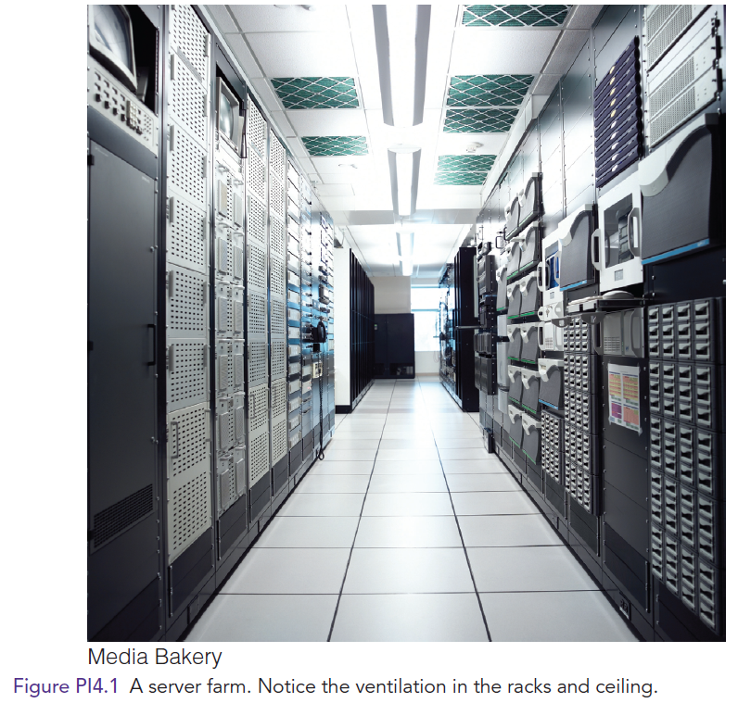
Server Farms

Slide 29
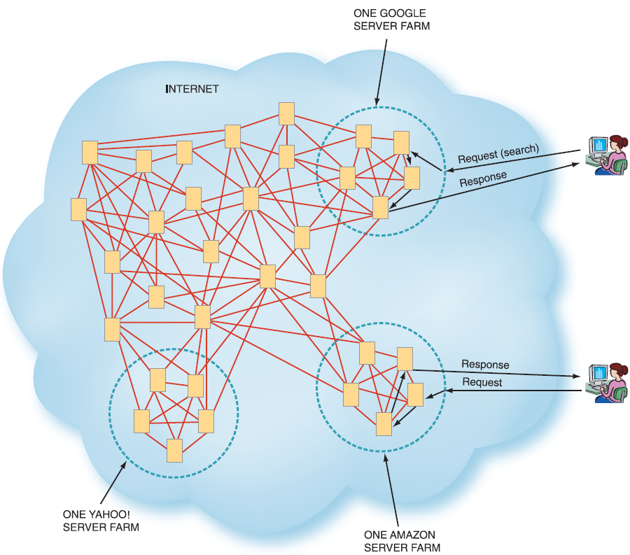
Server Farms in Relation to the Internet
Figure PI4.2

Slide 30
Amazon, whose online music store competes with Apple’s, has “moved music into it’s cloud” to solve two problems.
Music Libraries have typically been scattered
Amazon wants more people to buy music from its proprietary store instead of from Apple’s iTunes.

Slide 31
Different Types of Clouds
Public Cloud
Private Cloud
Hybrid Cloud
Vertical Cloud
Notes:
Public Clouds: shared, easily accessible, multi-customer IT infrastructures that are available nonexclusively to any entity in the general public (individuals, groups, and/or organizations). Public cloud vendors provide applications, storage, and other computing resources as services over the Internet.
Private Clouds: (also known as internal clouds or corporate clouds) IT infrastructures that can be accessed only by a single entity or by an exclusive group of related entities that share the same purpose and requirements, such as all of the business units within a single organization. Private clouds provide IT activities and applications as a service over an intranet within an enterprise. Enterprises adopt private clouds to ensure system and data security. For this reason these systems are implemented behind the corporate firewall.
Hybrid Clouds: composed of public and private clouds that remain unique entities, but are nevertheless tightly integrated. This arrangement offers users the benefits of multiple deployment models. Hybrid clouds deliver services based on security requirements, the mission-critical nature of the applications, and other company-established policies.
Vertical Clouds: cloud infrastructure and applications built for different businesses—the construction, finance, or insurance businesses, for example—thus building vertical clouds.

Slide 32
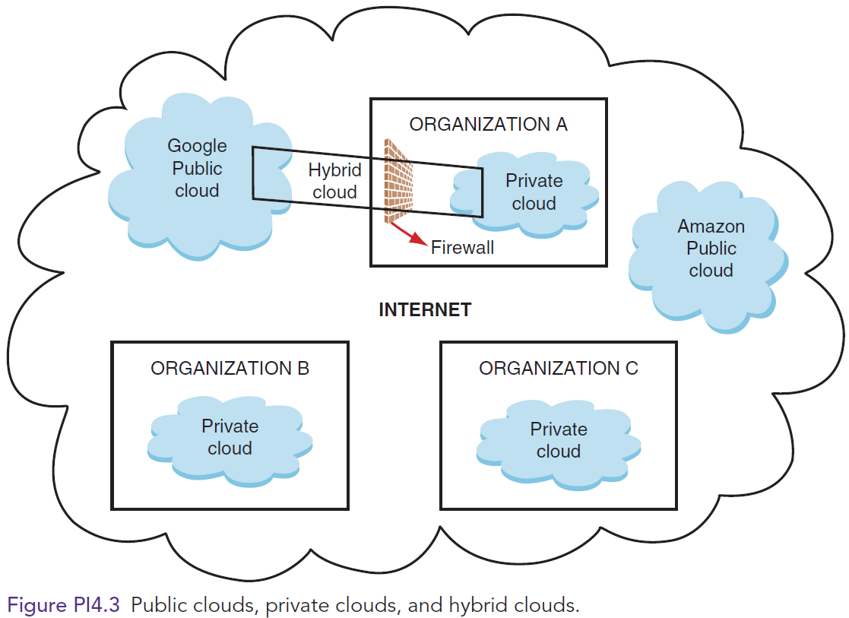
Public Clouds, Private Clouds, and Hybrid Clouds

Slide 33
Cloud Computing Services
Infrastructure-as-a-Service (IaaS)
Platform-as-a-Service (PaaS)
Software-as-a-Service (SaaS)
Notes:
Infrastructure-as-a-Service (IaaS): cloud computing providers offer remotely accessible servers, networks, and storage capacity. They supply these resources on demand from their large resource pools, which are located in their data centers.
Platform-as-a-Service (PaaS): customers rent servers, operating systems, storage, a database, software development technologies such as Java and .NET, and network capacity over the Internet. The PaaS model allows the customer both to run existing applications and to develop and test new applications.
Software-as-a-Service (SaaS): cloud computing vendors provide software that is specific to their customers’ requirements. SaaS is the most widely utilized service model, and it provides a broad range of software applications. SaaS providers typically charge their customers a monthly or yearly subscription fee. SaaS applications reside in the cloud instead of on a user’s hard drive or in a data center.

Slide 34
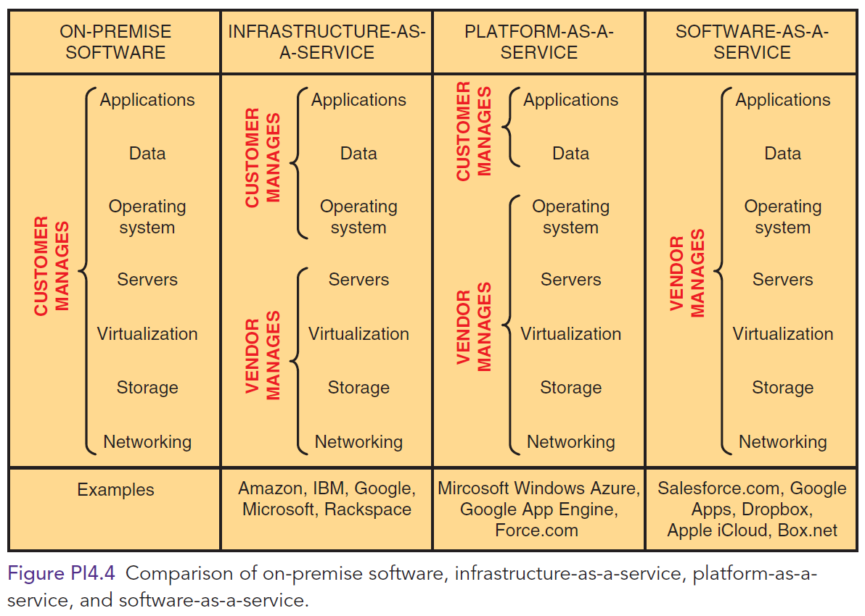
Comparison of On-premise Software, IaaS, PaaS, & SaaS

Slide 35
“THE CLOUD”

Slide 36
Benefits of Cloud Computing
Benefit 1: Making Individuals More Productive
Benefit 2: Facilitating Collaboration
Benefit 3: Mining Insights from Data
Benefit 4: Reduce Costs
Benefit 5: Expand the Scope of Business Operations
Benefit 6: Respond Quickly to Market Changes
Benefit 7: Customize Products and Services

Slide 37
Concerns and Risks with Cloud Computing
Concern 1: Legacy IT Systems
Concern 2: Reliability
Concern 3: Privacy
Concern 4: Security
Concern 5: The Regulatory and Legal Environment
Concern 6: Criminal Use of Cloud Computing

Slide 38
Amazon Web Services

Slide 39
PI4.7
Web Services and Service-Oriented Architecture
Web services
Benefits of Web Services
Service-oriented Architecture
Four Key Protocols of Web Services
Extensible Markup Language (XML)
Hypertext Markup Language (HTML)
HTML5
Notes:
Web Services: applications delivered over the Internet (the cloud) that MIS professionals can select and combine through almost any device, from personal computers to mobile phones. By using a set of shared standards, or protocols, these applications permit different systems to “talk” with one another.
------------------
Benefits of Web services:
The organization can utilize the existing Internet infrastructure without having to implement any new technologies.
Organizational personnel can access remote or local data without having to understand the complexities of this process.
The organization can create new applications quickly and easily.
------------------
Service-oriented Architecture: The collection of Web services used to build a firm’s IT applications. Businesses accomplish their processes by executing a series of these services.
Extensible Markup Language (XML): is a computer language that makes it easier to exchange data among a variety of applications and to validate and interpret these data.
Hypertext Markup Language (HTML): HTML is a page-description language for specifying how text, graphics, video, and sound are placed on a Web page document.
Hypertext Markup Language 5 (HTML5): enables users to embed images, audio, and video directly into a document without the use of add-ons (Adobe Flash Player). HTML5 also makes it easier for Web pages to function across different display devices, including mobile devices and desktops.
Simple Object Access Protocol (SOAP): a set of rules that define how messages can be exchanged among different network systems and applications through the use of XML. These rules essentially establish a common protocol that allows different Web services to interoperate.
Web Services Description Language (WSDL): creates the XML document describing the tasks performed by the various Web services. Tools such as VisualStudio.Net automate the process of accessing the WSDL, reading it, and coding the application to reference the specific Web service.
Universal Description, Discovery, and Integration (UDDI): allows MIS professionals to search for needed Web services by creating public or private searchable directories of these services.

Slide 40
Benefits of Web Services
The organization can utilize the existing Internet infrastructure without having to implement any new technologies.
Organizational personnel can access remote or local data without having to understand the complexities of this process.
The organization can create new applications quickly and easily.
Notes:
Benefits of Web services:
The organization can utilize the existing Internet infrastructure without having to implement any new technologies.
Organizational personnel can access remote or local data without having to understand the complexities of this process.
The organization can create new applications quickly and easily.

